Slide 1
Suspension report

Slide 2
What kind of data?
Removal Rate
Principal Suspension Rate
Superintendent Suspension Rate
SWD Principal/Superintendent and aggregate suspension rate
By enrollment

Slide 3
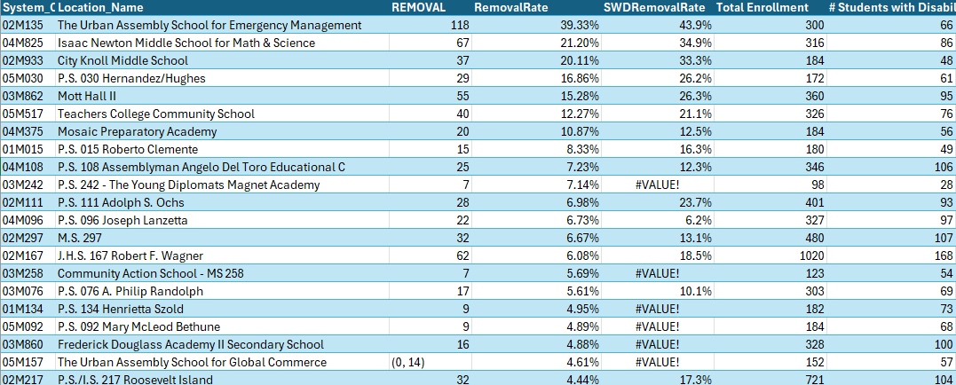
Removal Rate(M):

Slide 4
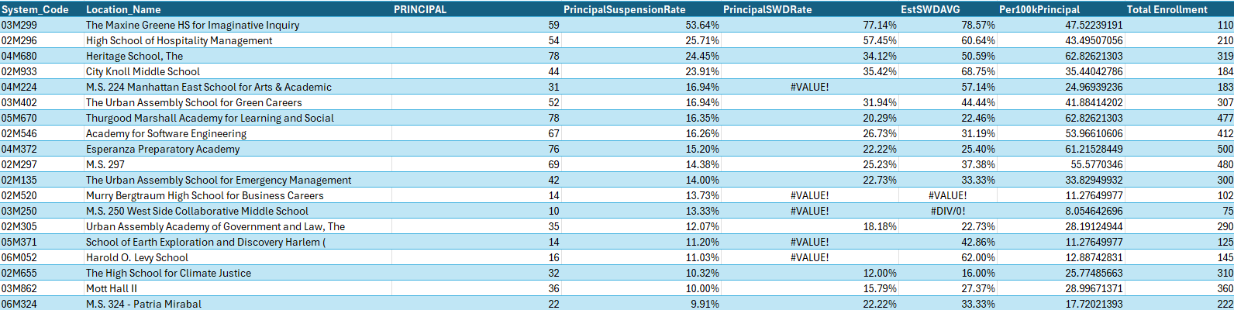
Principal Suspension Rate(M):

Slide 5
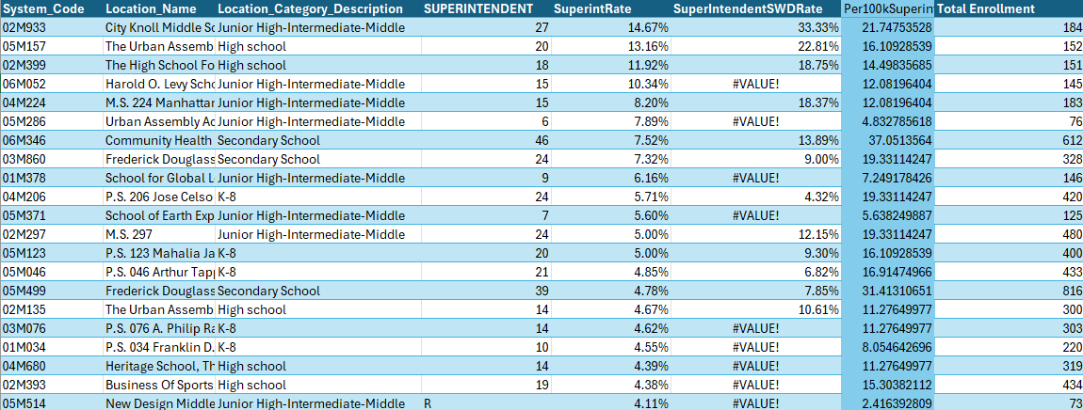
superintendent Suspension Rate(M):

Slide 6
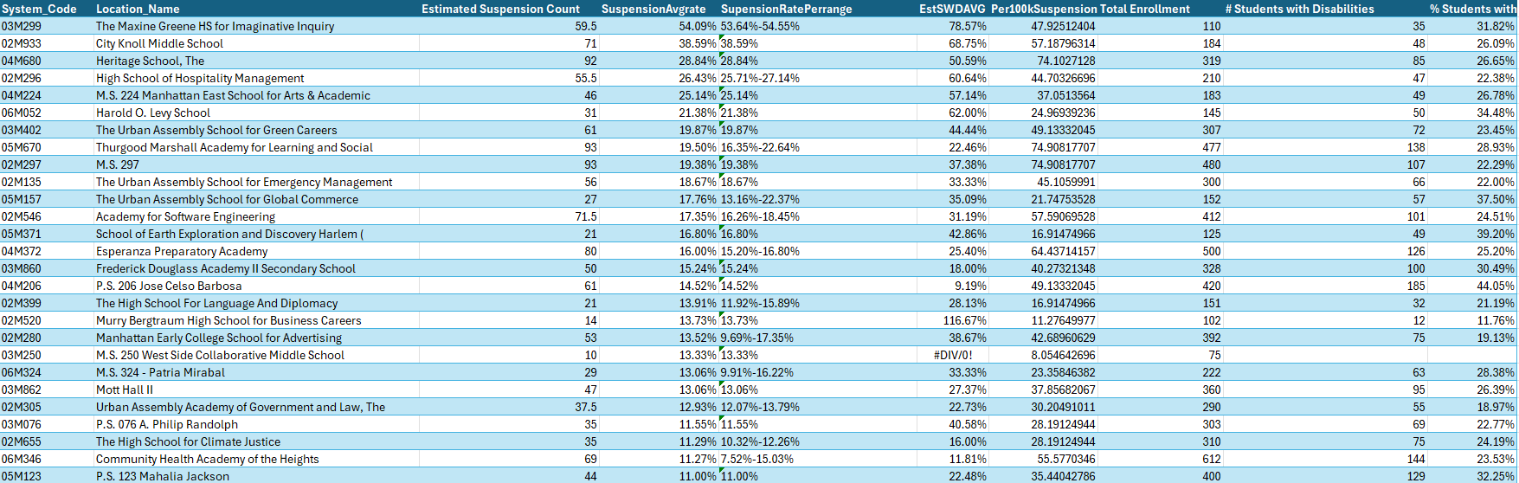
Total Suspension Rate(M):

Slide 7
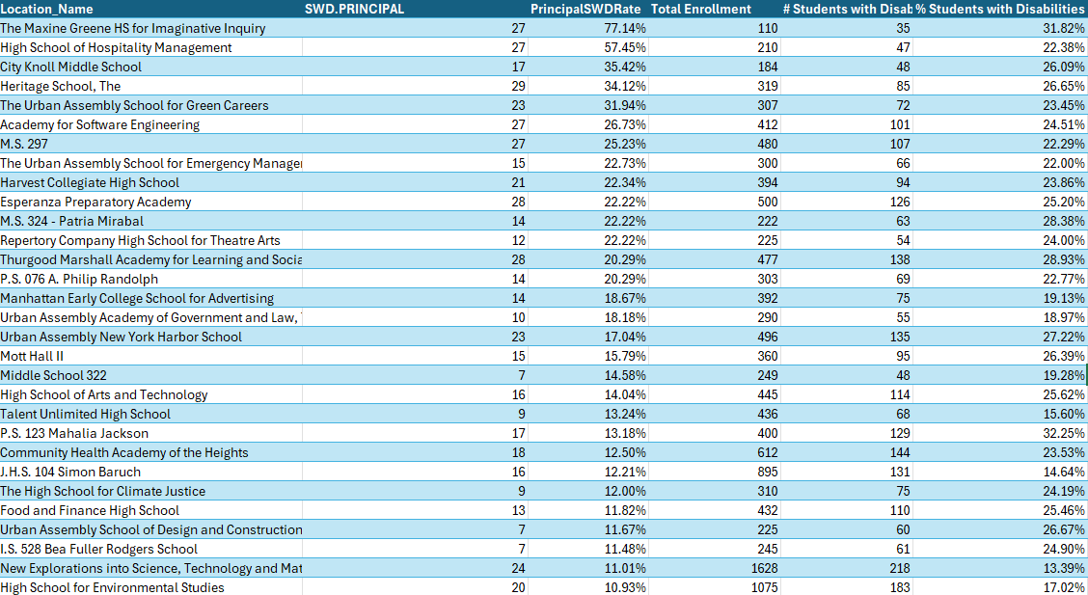
SWD Principal Suspension Rate(M):

Slide 8
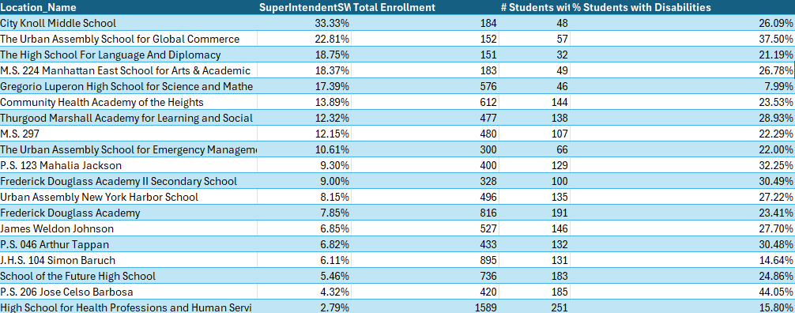
SWD Superintendent Suspension Rate(M):

Slide 9
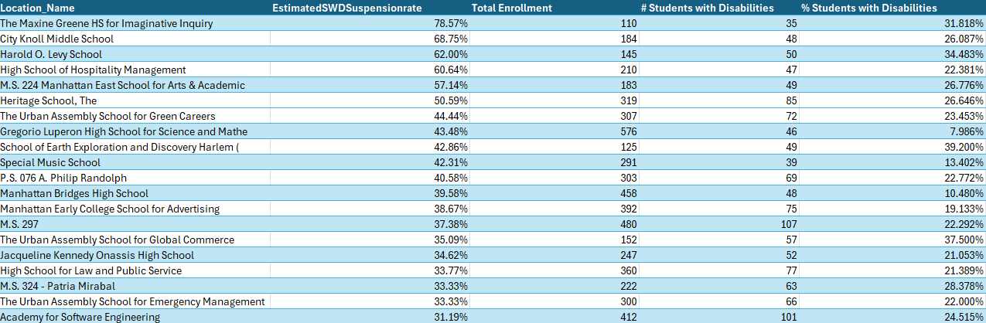
SWD total Suspension Rate(M):

Slide 10
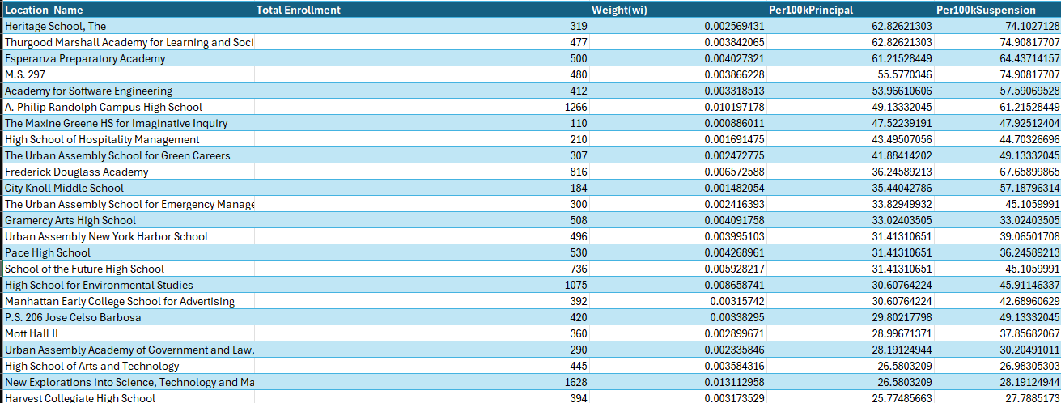
Weighted Suspension per 100k Students(M):

Slide 11
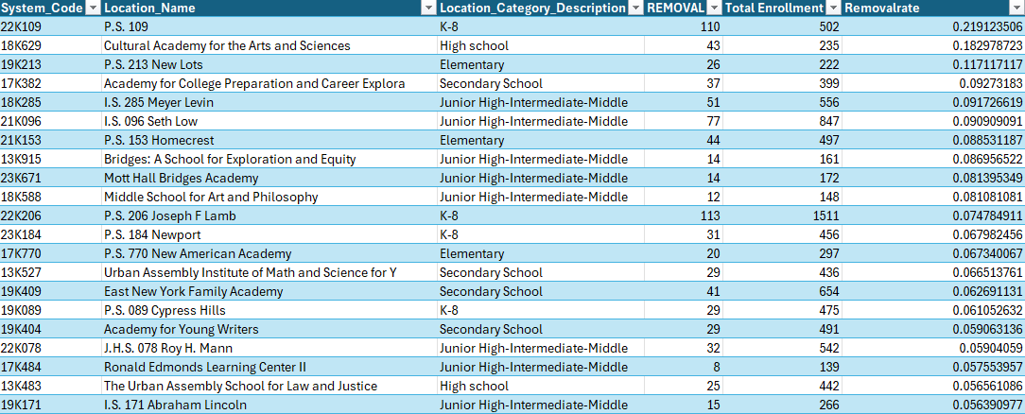
Removal Rate(K):

Slide 12
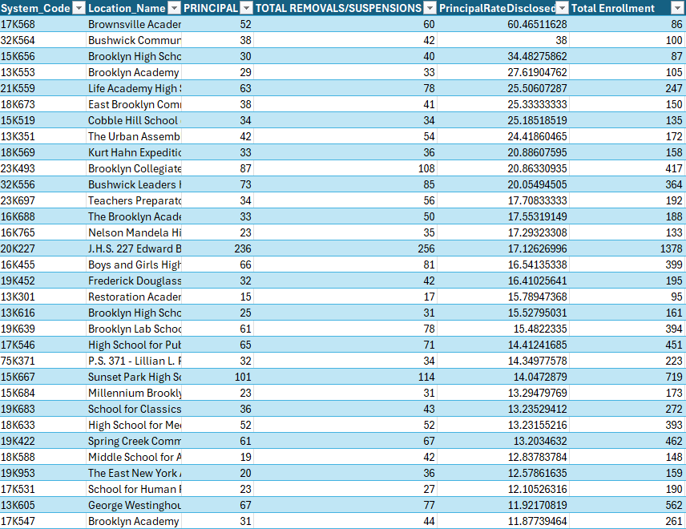
Principal Suspension Rate (K):

Slide 13
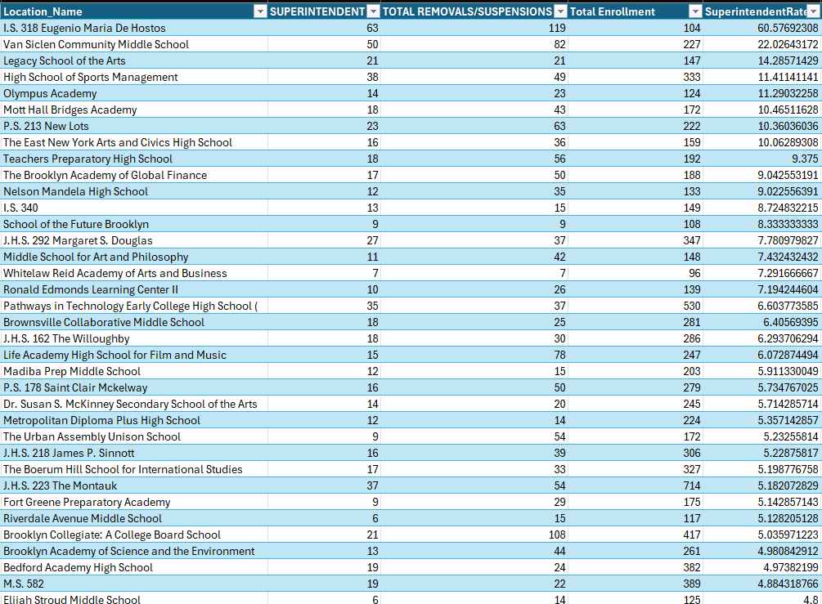
superintendent Suspension Rate(K):

Slide 14
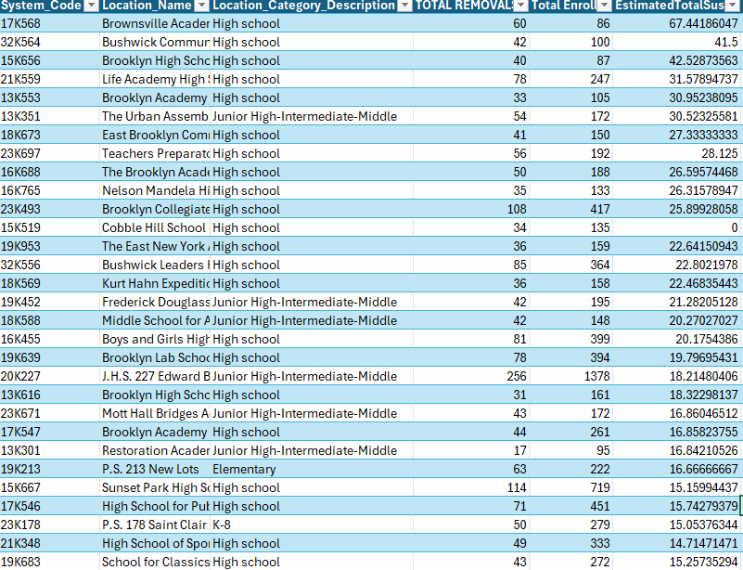
Total Suspension Rate(K):

Slide 15
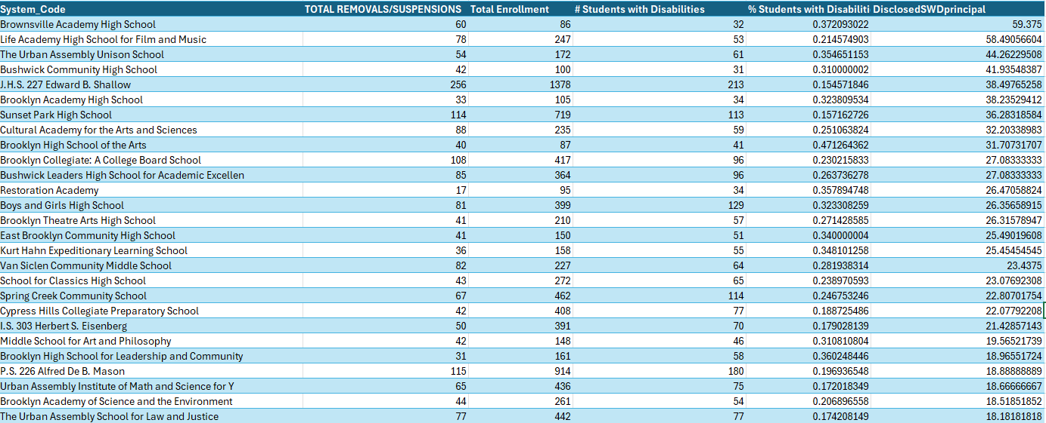
SWD Principal Suspension Rate(K):

Slide 16
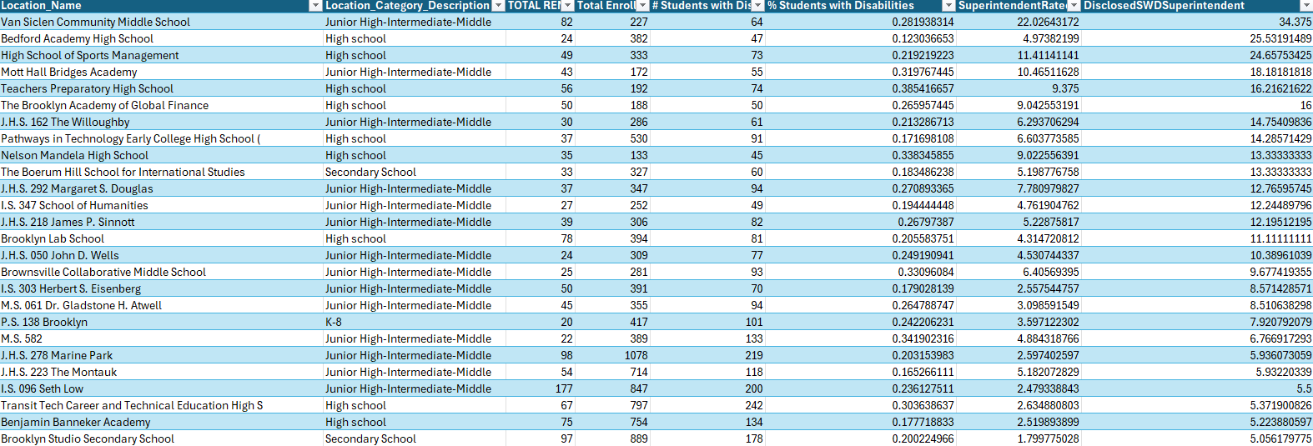
SWD Superintendent Suspension Rate(K):

Slide 17
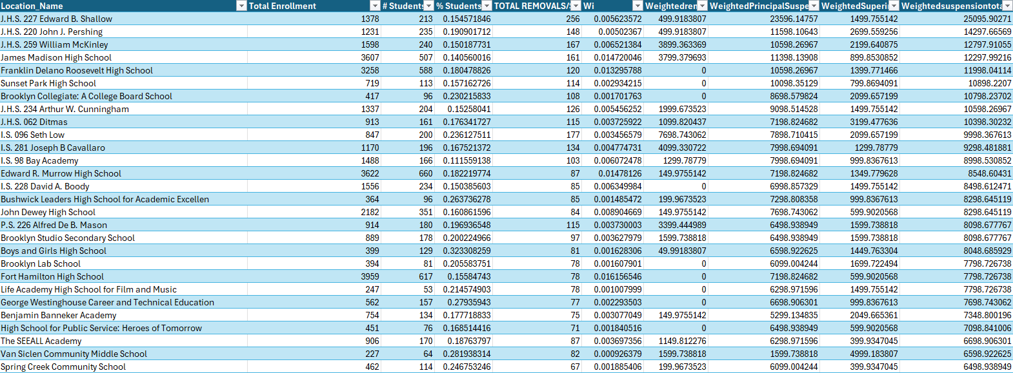
Weighted Suspension per 245K students (k):

Slide 18
THANK YOU

